Slide 1
Chapter 19: Diode Applications (Part 1)
Rectifier Circuits

Slide 2
Objectives
After completing Part 1 of this chapter, you will be able to:
Analyse and explain half-wave rectification
Analyse and explain full-wave rectification

Slide 3
Rectifiers
There are three basic types of rectifiers:
Half-wave rectifier
Full-wave rectifier with centre-tapped transformer
Full-wave bridge rectifier (the most commonly used)

Slide 4
19-1 Half-wave Rectifiers
Vin
V_{out}
t
t
The diode will convert input voltage (V_{in}) waveform into half wave output (V_{out}).
Only the positive half-cycles appear across the load.
Output is a pulsating dc voltage.

Slide 5
Positive Half Alternations
When the input (V_{in}) goes positive, the diode is forward-biased and conducts current through the load resistor R_{L.}
This will develop an output voltage V_{out} across it which has the same shape as the positive half-cycle of the input voltage

Slide 6
Negative Half Alternations
When the input goes negative during the second half of this cycle, the diode is reverse-biased.
No current flows into the load R_{L}(i.e. I_{o}=0), so the voltage across the load resistor is 0 V (V_{out}= I_{o} x R_{L}= 0 x R_{L}= 0 V).

Slide 7
Average Value of Half –wave Voltage
The average value of the half-wave voltage can be mathematically expressed as
V_{P}
V_{AVG}
t
2π

Slide 8
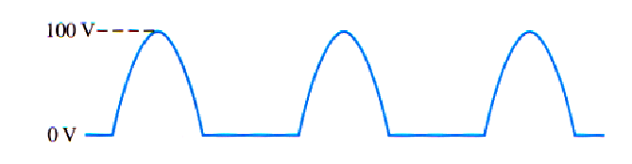
Example 19-1
Average Value of Half –wave Voltage
What is the average value of the half-wave rectified voltage in the diagram shown below?

Slide 9
Effect of Barrier Potential on Half –wave Rectifier Output
During the positive half-cycle, the input voltage must overcome the barrier potential before the diode becomes forward-biased
V_{p(in)}
+ 0.7V -
+
+
V_{out}
-
V_{p(out)}
0
t
R_{L}
V_{in}
I
0
t
V_{p(out)} = V_{p(in)} – 0.7

Slide 10
Peak Inverse Voltage (PIV)
The maximum value of reverse voltage (PIV) occurs at the peak of each negative alternation of the input voltage when the diode is reverse-biased.
Vin
+
+
t_{p}
0
t
R_{L}
V_{in}
+
I = 0
-Vp_{(in)}
V_{in} = IR_{L} + V_{DIODE}
At t_{p}, -V_{P} = 0 + V_{DIODE}
∴ PIV = V_{p(in)}

Slide 11
Half –wave Rectifier with Transformer-coupled Input Voltage
N_{pri} : N_{sec}
V_{in}
V_{pri}
V_{sec}
R_{L}
transformer
A transformer is often used to couple the ac input voltage from the source to the rectifier.
It provides two advantages:
1) It allows the source voltage to be stepped up or down as needed
2) The ac source is electrically isolated from the rectifier, thus preventing a shock hazard in the secondary

Slide 12
Half –wave Rectifier with Transformer-coupled Input Voltage
Example 19-2
What is the peak value of the output voltage in the circuit below if V_{in} = 10V_{(peak)} ?
2 : 1
V_{in}
V_{pri}
V_{sec}
1 KΩ
transformer
Solution

Slide 13
19-2 Full–wave Rectifiers
Most commonly used type in dc power supplies
Allows unidirectional (one-way) current to the load during the entire input cycle
Output frequency is twice that of input frequency
Average value for a full-wave rectified sinusoidal voltage is twice that of half-wave
Vout
Vin
Full-wave
rectifier
0
t
0
t
2
V
V
=
p
AVG
π

Slide 14
The Full–wave Centre-tapped Transformer Rectifier
This uses two diodes connected to the secondary of a centre-tapped transformer
D₁
Vsec
2
CT
V_{in}
Vsec
2
R_{L}
D₂

Slide 15
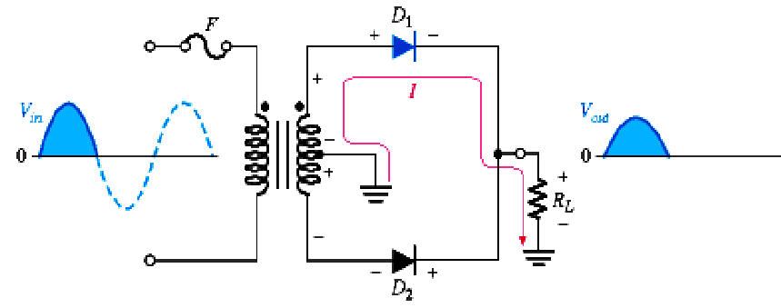
During Positive Half-cycles
D₁ is forward biased, D₂ is reverse-biased
Current path is through D₁ and load resistance R_{L}

Slide 16
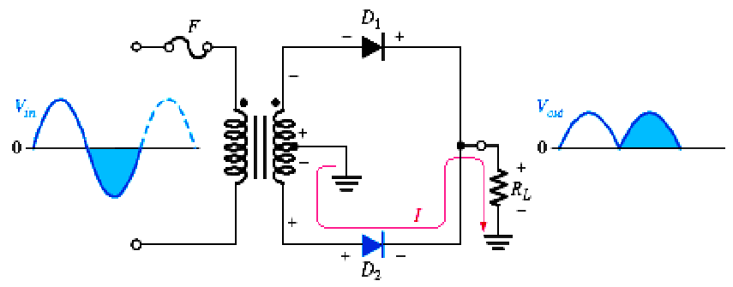
During Negative Half-cycles
D₂ is forward biased, D₁ is reverse-biased
Current path is through D₂ and load resistance R_{L}

Slide 17
Summary
Current through the load resistor is in the same direction during the entire input cycle, so the output voltage always has the same polarity
0
D₁
Vin
Vout
0
t
0
CT
t
R_{L}
0
D₂

Slide 18
Peak Output Voltage
The peak output voltage of a full-wave centre-tapped rectifier is always one-half of the total peak secondary voltage less the barrier potential (or diode drop).
Re-arranging the above equation,
Once the peak output voltage is known, the average output can be calculated :

Slide 19
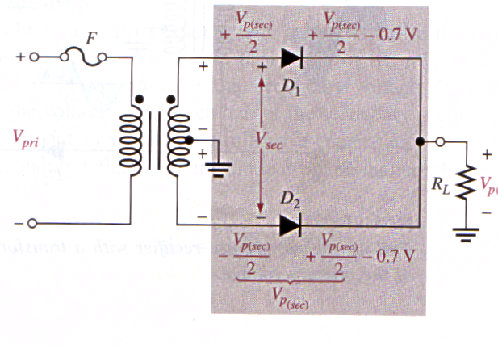
Peak Inverse Voltage (PIV)
When D₂ is reverse biased, the peak inverse voltage (PIV) across D₂ is the potential difference between the cathode and anode.

Slide 20
Peak Inverse Voltage (PIV)
As derived previously :
Therefore,
PIV
=
2
V
+
0
.
7
V
p
(
out
)
Peak Inverse Voltage (PIV) is twice the peak output voltage plus a diode drop.

Slide 21
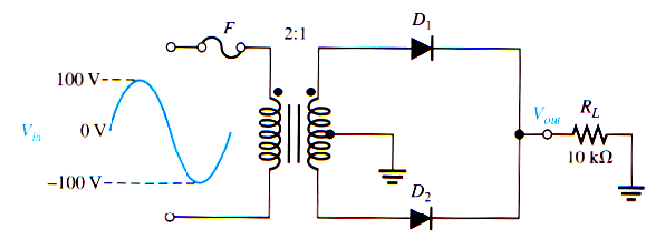
Peak Inverse Voltage (PIV)
Example 19-3
Calculate : (a) half of the secondary winding peak voltage
(b) peak value of the output voltage
What is the PIV rating of the diodes used?

Slide 22
Peak Inverse Voltage (PIV)
Solution
PIV
=
2
V
+
0
.
7
V
p
(
out
)

Slide 23
Full-wave Bridge Rectifier
Vin
D₁
Vout
D₃
0
0
t
t
D₂
R_{L}
D₄
This circuit uses four diodes

Slide 24
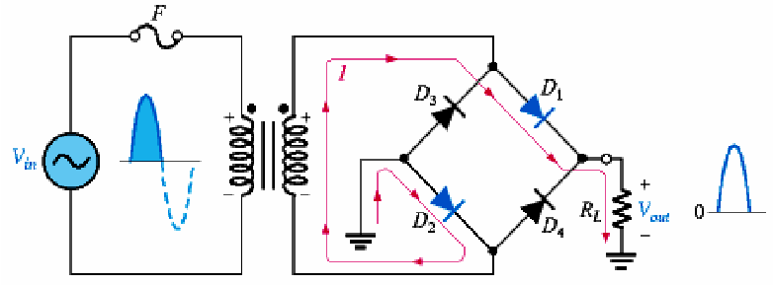
During Positive Half-cycles
D₁ and D₂ are forward-biased and conduct current in the direction shown
A voltage is developed across load resistance R_{L}
D₃ and D₄ are reverse-biased

Slide 25
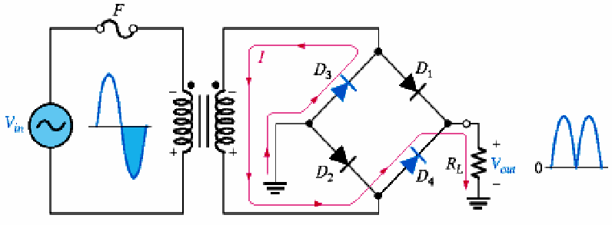
During Negative Half-cycles
D₃ and D₄ are forward-biased and conduct current in the same direction through R_{L} as during the positive half-cycle
D₁ and D₂ are reverse-biased

Slide 26
Bridge Output Voltage
Vin
D₁
D₃
0
t
Vout
D₂
R_{L}
D₄
0
t
Two diodes are always in series with the load resistor during both half-cycles. Consider each has a voltage drop of 0.7 V,
The average output voltage will hence be

Slide 27
Peak Inverse Voltage of Bridge rectifier
V
p
(
out
)
=
V
−
1
.
4
V
p
(sec)
R_{L}
PIV
- 0.7 V
PIV
=
V
+
0
.
7
V
p
(
out
)

Slide 28
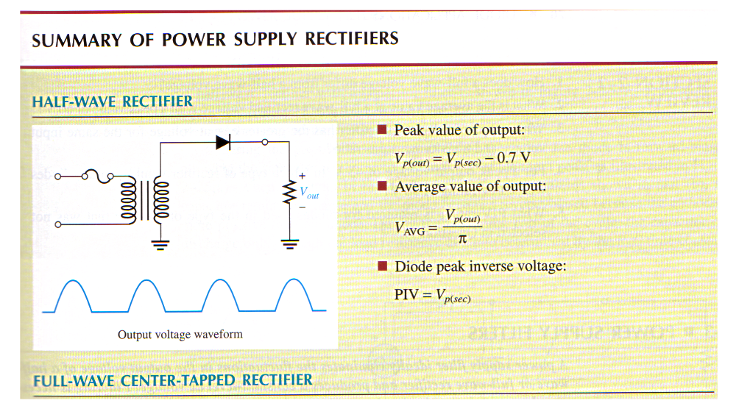
Summary of Power Supply Rectifiers

Slide 29
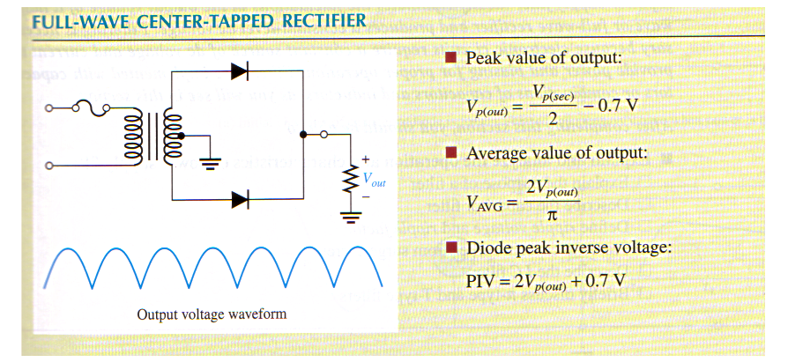

Slide 30
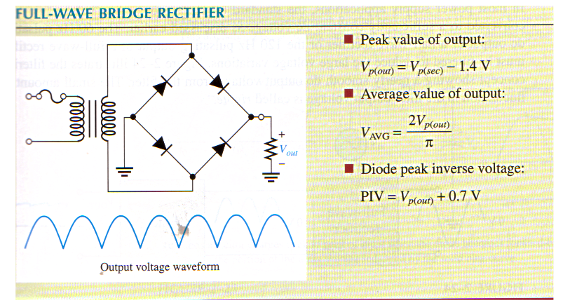

Slide 31
End of Chapter 19 (Part 1)

